Slide 1
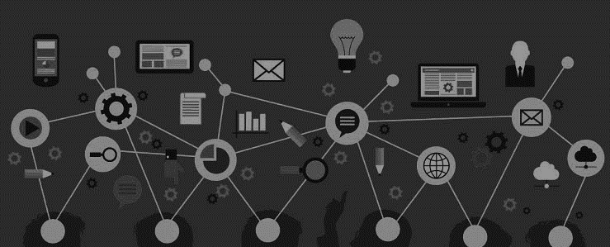
Title : AI Proctoring Tool
Theme: Artificial Intelligence
Team Name:CodeX

Slide 2
1. The Overview
Create an overview of your Innovation
We are a group of AI Enthusiasts. We like to implement AI and ML wherever possible.
We usually replace humans with AI.
LEARN NOW

Slide 3
2. The Problem
What problem are you trying to solve? Is it really a problem?
We are tackling the issue of Proctoring. Time, Money and Manpower are the key pain points.
This product is targeted towards corporate and educational institutions.
We utilize state of the art AI and ML to check the pose, posture and gaze using a single camera. Audio and Behavior analysis is done using Multi Modal Models, which are used to ensure that the proctoring is done effectively.
LEARN NOW

Slide 4
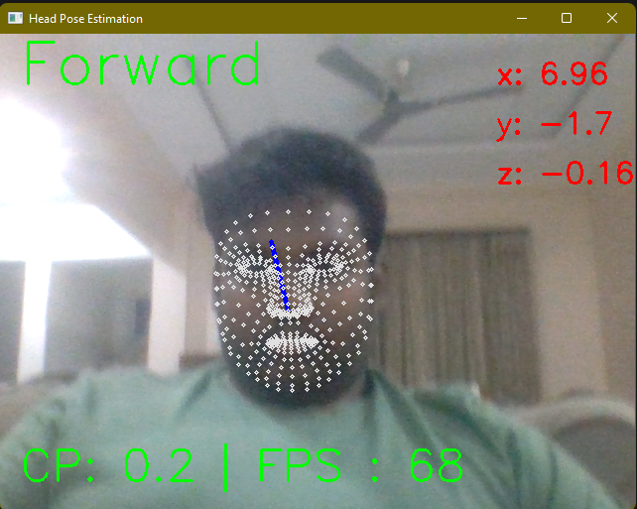
3.The Solution
Describe how are you planning to solve the problem
We utilize AI and ML to estimate pose, posture and gaze of the testee. All this data is then fed into another model to determine the authenticity of the answers given.
This modus operandi reduces the manpower, time and money required to effectively proctor any application. Recordings are saved and available for later review.
LEARN NOW

Slide 5
4. The innovation
Describe how are your solution is relevant to the customers
Include explainer videos, demos, product screenshots
Include PoCs
Include testimonials of actual customers
Allows for remote assessment
Reduces cost
Reduces manpower required.
Detailed reports.
Academic Integrity
Flexibility
Privacy and Reduced Bias
LEARN NOW

Slide 6
5. Market & Opportunity
Know, or at least attempt to predict, the size of your target market
The market is large as number of educational institutions, corporations needs the proctoring tools for their online exams.
The SAM includes universities, technical schools, corporate training programs, and hackathon organizers worldwide.
The vast SAM for our exam proctoring tool spans global educational institutions, corporations, and hackathon organizers. With a projected $375 billion e-learning market by 2026, we target universities, technical schools, and corporate programs, aligning with the rising demand for secure online assessments.
LEARN NOW

Slide 7
6. The Technology/Innovation
Describe how are you planning to solve the problem
The AI and ML Models are currently working in isolation. They however are optimized.
TRL 3 : Experimental PoC
IP: Custom ML Models and the pipeline.
Uniqueness: Complete elimination of human as a necessity.
Current : Integration of all models and storage.
Near Future: Decoupling of UI and functionality.
Future: Accessible and Personalized Environments.
Far Future: Incorporation of new research in AI fields.
LEARN NOW

Slide 8
7. Competitive Landscape
What are the alternative solutions to the problem you are trying to solve?
METAL
METAL requires a human as a backup, it is expensive.
We remove humans from the equation entirely, removing a collection of bias
Barriers to entry – Key partnerships, IP
Opportunities for collaboration and co-creation
LEARN NOW

Slide 9
8. LEAN CANVAS
Sketch out a business model design of your
idea using a 1-page template (Lean Canvas)
Clearly and concisely fill all the blocks of a lean canvas
Lean Canvas help sketch out several variants of your idea, It is a rapid
Idea modeling tool. That helped startups identify and home in on several promising customer-problem-solution possibilities.
LEARN NOW

Slide 10
9. Business Model
How are you planning to make money? Show a schedule when you expect revenues to pour in
Our product generates revenue through a subscription-based model, offering tiered plans for educational institutions, corporations, and hackathon organizers. Additional revenue streams include licensing for customized features and ongoing customer support services.
Our viable business model centers on a subscription-based revenue stream, catering to educational institutions, corporations, and hackathon organizers. This stable income source is complemented by potential earnings from licensing for tailored features and dedicated customer support services, ensuring sustained growth and investor confidence.
LEARN NOW

Slide 11
10. The Team
Show the people behind the idea and briefly describe their role
Dev Parapalli
Vaibhav Kothe
Students of GCOE, Nagpur Both of us have significant experience with AI and Deployment.
Vaibhav is an AI and ML Connoisseur, has worked on multiple projects, some of which are deployed in industry.
Dev is an all-rounder, taking on the role of the full-stack developer for this project.
LEARN NOW

Slide 12
Thankyou

